Slide 1

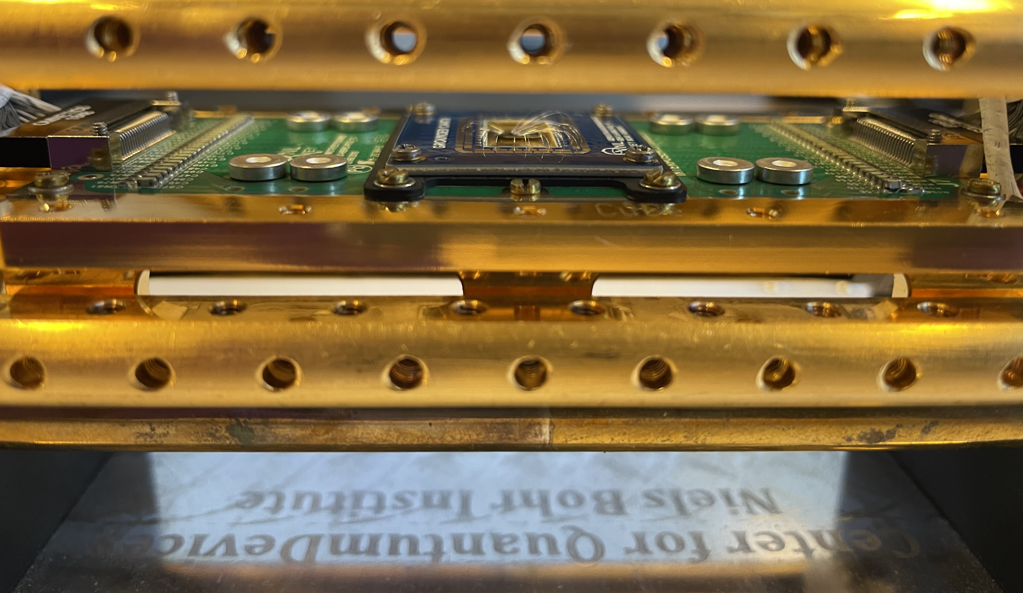
Welcome to the Center for Quantum Devices (Qdev)

Slide 2
Who are we?
Harry
Amalie
Master student
Experimental work on

Slide 3
What are Qdev doing?
Qdev
Experiments
Theory
Exploring Quantum phenomena in superconducters.
Notes:
Explain what is superconductors

Slide 4

What does quantum mean?
Physical properties can have quantized values
Quantized energy Atomic electron orbitals
Quantized light Photons

Slide 5
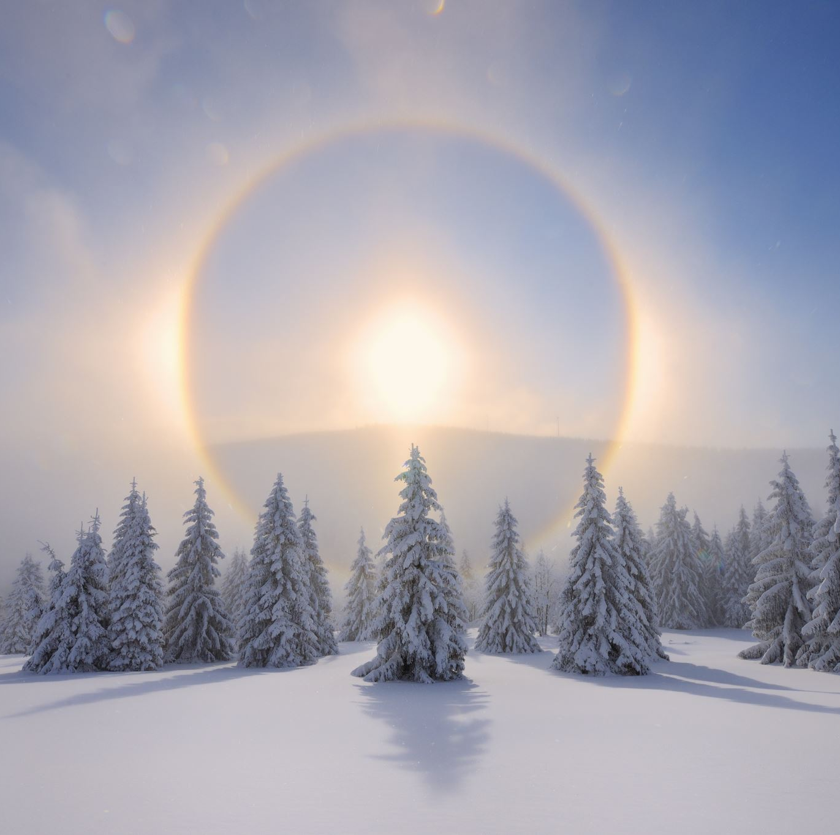
Quantum is extreme
Extremely cold temperatures
Extremely small length
Extremely high energies

Slide 6
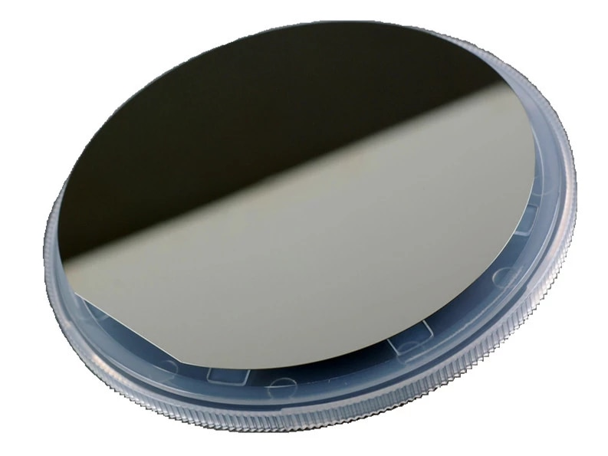

Slide 8
Cleaning

Slide 9
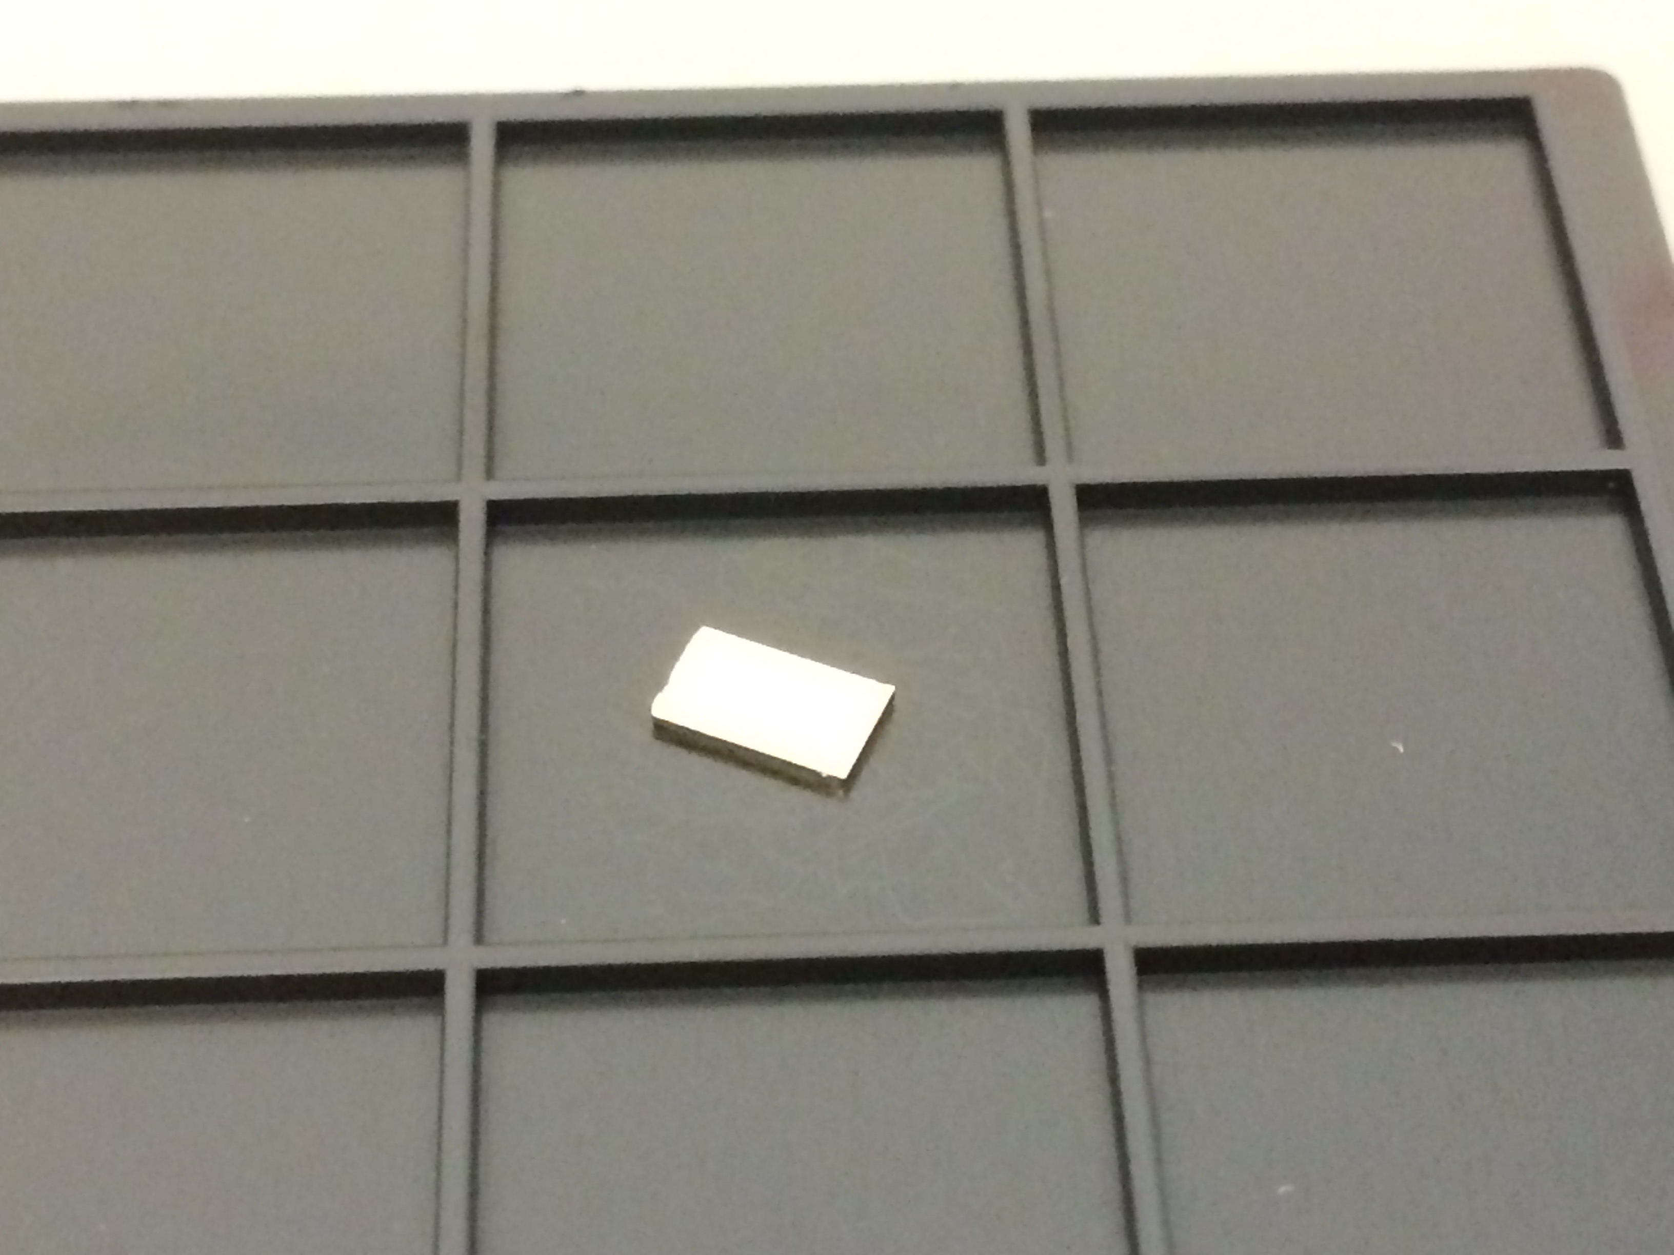
3 mm
5 mm

